Slide 1

NATIONAL UNIVERSITY OF MODERN LANGUAGES
Faculty of Engineering and Computing
Department of Software Engineering

Slide 2

SOFTWARE DESIGN AND ARCHITECTURE
LECTURE NO. 3
Introduction to Software Engineering Design
Course Instructor: | Mr. Ahsan Arif
 | Lecturer Department of Software Engineering NUML Islamabad
Date: October 02, 2024
Software Engineering Design: Theory and Practice

Slide 3
LECTURE CONTENTS
  Introduction to Use Case Identification
    Use Case Writing (fully dressed use case)
  Introduction to Use Case Modelling
  Use Case Model Generation
Date: October 02, 2024
Software Engineering Design: Theory and Practice

Slide 4

INTRODUCTION TO USE CASE IDENTIFICATION
What is USE CASE and USE CASE Diagram?
USE CASE:
  Cases of the usages by the user of the system
  We can have multiple Use Cases in a system
Use Case is nothing but Scenario
“A Textual Artefacts”
Pictorially we represents these scenarios by USE CASE diagram
It is representing the dynamic behavior of a system. It is used different notations like use cases, actors, and their relationships. It focuses on system’s requirements and functionality.
Date: October 02, 2024
Software Engineering Design: Theory and Practice

Slide 5


UNDERSTANDING USE CASES: IDENTIFICATION AND WRITING
Use cases are a fundamental concept in software development. They describe the interactions between a system and its users (actors) to achieve specific goals. Let’s break down the two key aspects:
  Use Case Identification
  Use Case Writing (Fully Dressed Use Case)
Date: October 02, 2024
Software Engineering Design: Theory and Practice

Slide 6
Use Case Identification
This is the process of finding all the functionalities the system should provide. Here’s how to identify use cases:
Actors | Start by identifying the actors who interact with the system. An actor can be a human user, another software system, or an external device.
Actor Needs | Once you have the actors, consider what they need from the system. What tasks do they want to accomplish? This leads you to potential use cases.
Brainstorming | Brainstorm with stakeholders (users, developers, etc.) to create a comprehensive list of use cases.
Date: October 02, 2024
Software Engineering Design: Theory and Practice
Notes:
The first efforts focused on unifying three popular modeling methods:
The Booch method, by Grady Booch
The object-oriented software engineering method (OOSE), by Ivar Jacobson
The object modeling technique (OMT) by James Rumbaugh
The UML is a language for
Visualizing
Specifying
Constructing
Documenting

Slide 7
Use Case Writing (Fully Dressed Use Case)
After identifying the use cases, we can document them in detail. A fully dressed use case provides a clear picture of the interaction between the actor and the system. Here’s what it typically includes:
Use Case ID | A unique identifier that is helpful for tracking the use case record.
Use Case Name | State a concise, results-oriented name for the use case. These reflect the tasks the user needs to be able to accomplish using the system.
Use Case History | Created By Supply the name of the person who initially documented this use case. Date Created Enter the date on which the use case was initially documented. Last Updated By Supply the name of the person who performed the most recent update to the use case description. Date Last Updated Enter the date on which the use case was most recently updated.
Date: October 02, 2024
Software Engineering Design: Theory and Practice
Notes:
The first efforts focused on unifying three popular modeling methods:
The Booch method, by Grady Booch
The object-oriented software engineering method (OOSE), by Ivar Jacobson
The object modeling technique (OMT) by James Rumbaugh
The UML is a language for
Visualizing
Specifying
Constructing
Documenting

Slide 8
Actors | Actors are the people or the systems who interact with the use cases. In other words, we can say that actors perform the functional requirements. For example, the title “Register Employee” is the functional requirement representing the use case and it can be performed by an actor.
Brief description | A brief textual description of what the use case does or Summary of the Use Case. Describe the Use Case not more than 5 lines.
Preconditions | Preconditions are the requirements that must fulfill before the activity.
Postconditions | Postconditions represents the finish of the use case successfully or unsuccessfully. Its can be further extended to the main success scenario and alternate scenario.
Path | The path is the step-by-step action that places between the actor and the system. Paths come in three types:
Date: October 02, 2024
Software Engineering Design: Theory and Practice
Notes:
The first efforts focused on unifying three popular modeling methods:
The Booch method, by Grady Booch
The object-oriented software engineering method (OOSE), by Ivar Jacobson
The object modeling technique (OMT) by James Rumbaugh
The UML is a language for
Visualizing
Specifying
Constructing
Documenting

Slide 9
Basic flow is the normal flow of action in an application. For example, in the login page after entering user name and password the next screen should appear is the basic flow.
Alternative flow are the alternative actions that can be performed. For example, in the login page the alternative flow will be checking the existence of the user name entered.
Exception are the activities in case of the exception thrown. They are the flow of events which will happen in case of the error.
Date: October 02, 2024
Software Engineering Design: Theory and Practice
Notes:
The first efforts focused on unifying three popular modeling methods:
The Booch method, by Grady Booch
The object-oriented software engineering method (OOSE), by Ivar Jacobson
The object modeling technique (OMT) by James Rumbaugh
The UML is a language for
Visualizing
Specifying
Constructing
Documenting

Slide 10
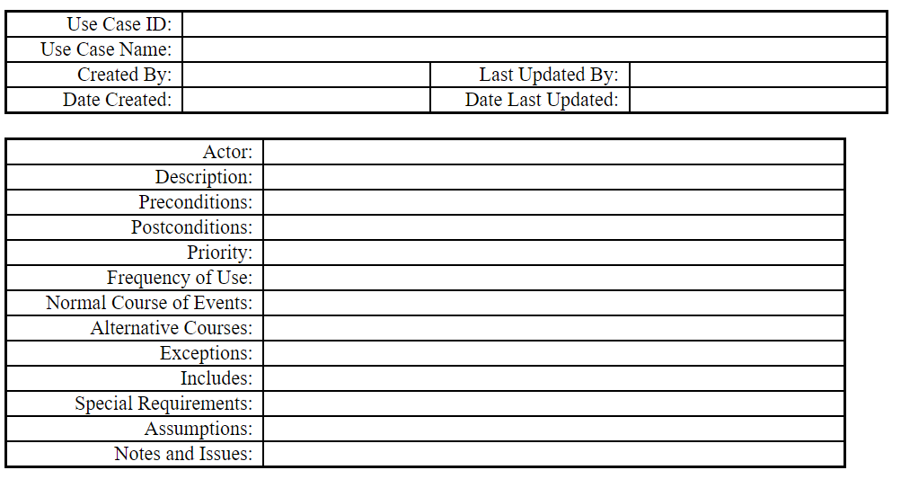
Use Case Template…
Date: October 02, 2024
Software Engineering Design: Theory and Practice
Notes:
The first efforts focused on unifying three popular modeling methods:
The Booch method, by Grady Booch
The object-oriented software engineering method (OOSE), by Ivar Jacobson
The object modeling technique (OMT) by James Rumbaugh
The UML is a language for
Visualizing
Specifying
Constructing
Documenting

Slide 11
Benefits of Fully Dressed Use Cases
Clarity: Detailed use cases promote clear communication between stakeholders about system functionalities.
Requirements Gathering: They help gather and document system requirements effectively.
Testing: Use cases serve as a basis for creating test cases to ensure the system functions as intended.
Design: Detailed use cases can inform system design decisions.
Date: October 02, 2024
Software Engineering Design: Theory and Practice
Notes:
The first efforts focused on unifying three popular modeling methods:
The Booch method, by Grady Booch
The object-oriented software engineering method (OOSE), by Ivar Jacobson
The object modeling technique (OMT) by James Rumbaugh
The UML is a language for
Visualizing
Specifying
Constructing
Documenting

Slide 12
INTRODUCTION TO USE CASE MODELLING
One of the primary challenges in a system design process is the ability to elicit the correct and necessary system requirements from the stakeholders and specify them in a manner understandable to them so those requirements can be verified and validated.
  Use Case Modeling is a technique for capturing the functional requirements of a system.
  It focuses on the interactions between actors (users or external systems) and the system itself.
  It helps us understand how the system will be used to achieve specific goals.
Date: October 02, 2024
Software Engineering Design: Theory and Practice

Slide 13
KEY COMPONENTS OF USE CASE MODELING
Actors:
  Represent users or external systems that interact with the system. (e.g., Customer, Administrator)
Use Cases:
  Represent sequences of actions that an actor performs to achieve a goal. (e.g., Place Order, Manage Account)
System:
  Represents the software application being developed. (e.g., E-commerce Platform, Library Management System)
Date: October 02, 2024
Software Engineering Design: Theory and Practice

Slide 14
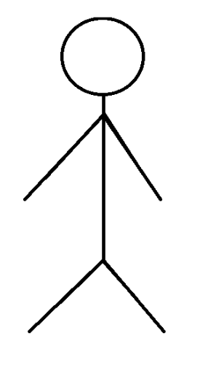
Actors:
An actor is someone or something that must interact with the system under development.
Usually represented by with a Stick Figure.
An actor may be:
  People
  Computer hardware and devices
  External System
Date: October 02, 2024
Software Engineering Design: Theory and Practice

Slide 15
Use Case:
A use case is a pattern of behavior, the system exhibits.
The use cases are sequence of actions that the user takes on a system to get particular target.
USE CASE is dialogue between an actor and the system.
Represented by Oval Shape.
Login
Date: October 02, 2024
Software Engineering Design: Theory and Practice

Slide 16
System Boundary:
It is shown as a rectangle.
It helps to identify what is external versus internal, and what the responsibilities of the system are.
The external environment is represented only by actors.
Use Case Modeling Tool
Date: October 02, 2024
Software Engineering Design: Theory and Practice

Slide 17
Relationship:
Relationship is an association between use case and actor.
There are several Use Case relationships:
Association
Generalization
Include
Extend
Date: October 02, 2024
Software Engineering Design: Theory and Practice

Slide 18
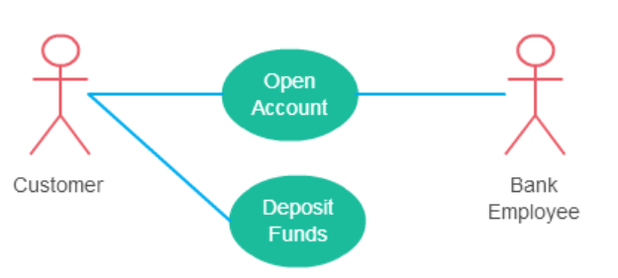
Relationship - Association
An association is the communication path between and an actor and the use case that it participates in.
It is shown as a solid line.
It does not have an arrow, and is normally read from left to right.
An actor must be associated with at least one use case. An actor can be associated with multiple use cases. Multiple actors can be associated with a single use case.
Date: October 02, 2024
Software Engineering Design: Theory and Practice

Slide 19
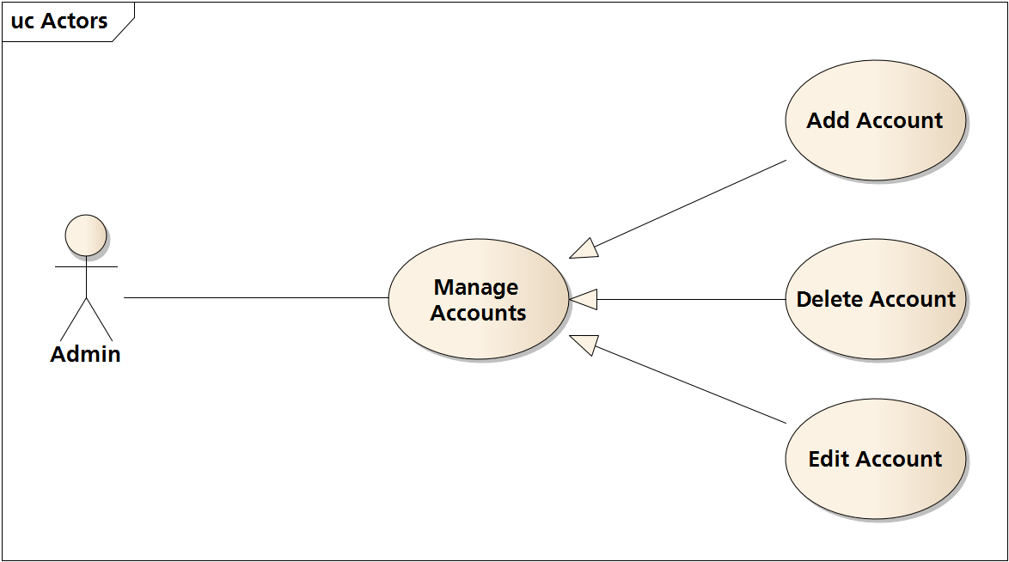
Relationship - Generalization
Generalization is a relationship between a general use case and a more specific use case that inherits and extends features to it.
It is shown as a solid line with a closed arrow point.
Date: October 02, 2024
Software Engineering Design: Theory and Practice

Slide 20
Relationship - Include
Include relationships insert additional behavior into a base use case
The “Include relationship” is shown by the dotted line with arrow and arrow must point to the included use case from the base use case and the keyword <<include>>
Include relationship show that the behavior of the included use case is part of the including (base) use case.
  The main reason for this is to reuse common actions across multiple use cases. In some situations, this is done to simplify complex behaviors. Few things to consider when using the <<include>> relationship.
    The base use case is incomplete without the included use case
    The included use case is mandatory and not optional
Date: October 02, 2024
Software Engineering Design: Theory and Practice

Slide 21
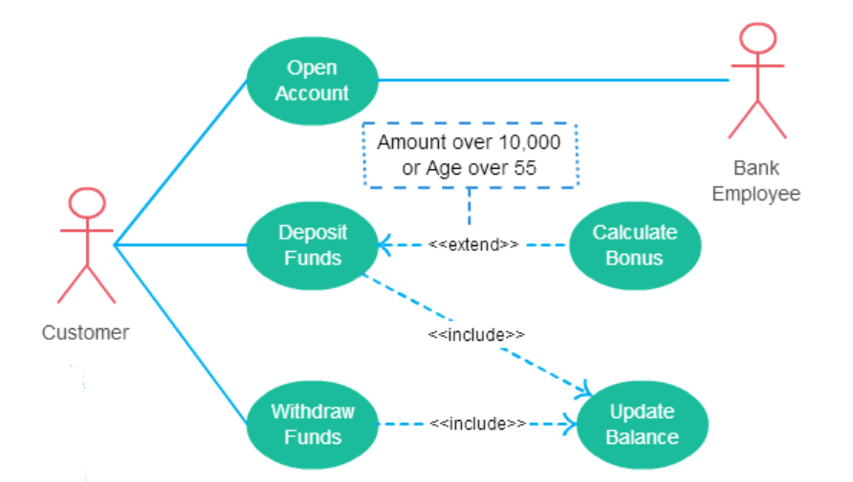
Relationship - Include
Date: October 02, 2024
Software Engineering Design: Theory and Practice

Slide 22
Relationship - Extend
As the name implies it extends the base use case and adds more functionality to the system
It is shown as a dotted line with an arrow point and labeled <<extend>>
Here are a few things to consider when using the <<extend>> relationship:
  The extending use case is dependent on the extended (base) use case. In the below diagram the “Calculate Bonus” use case doesn’t make much sense without the “Deposit Funds” use case.
  The extending use case is usually optional and can be triggered conditionally. In the diagram, you can see that the extending use case is triggered only for deposits over 10,000 or when the age is over 55.
  The extended (base) use case must be meaningful on its own. This means it should be independent and must not rely on the behavior of the extending use case.
Date: October 02, 2024
Software Engineering Design: Theory and Practice

Slide 23
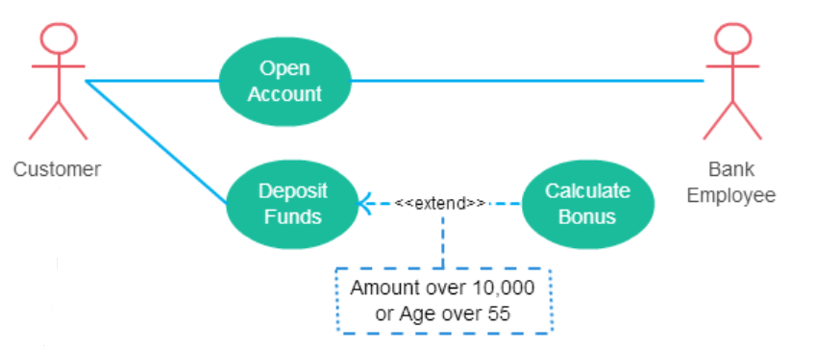
Relationship - Extend
Date: October 02, 2024
Software Engineering Design: Theory and Practice

Slide 24
Thank You...
Mr. Ahsan Arif
Lecturer (Dept. of Software Engineering)
ahsanarif.se42@gmail.com

